Slide 1

Low-Fidelity Design
Window
Mixed Reality
Max Freundlich, Kristen Law, Elisa Lupin-Jimenez
Notes:
Good afternoon!
I am Elisa, and my partners Kristen and Max are out in the audience among you.
Thank you for coming out to our first-ever prototype demonstration for our application Window.

Slide 2

Overview
Value Proposition
Selected Interface
Low-Fi Prototype
Task Flows
Methods
Results
UI Changes
Notes:
click

Slide 3
Overview
Value Proposition
Selected Interface
Low-Fi Prototype
Task Flows
Methods
Results
UI Changes
Notes:
- We’ve got quite a bit to cover with all of you

Slide 4
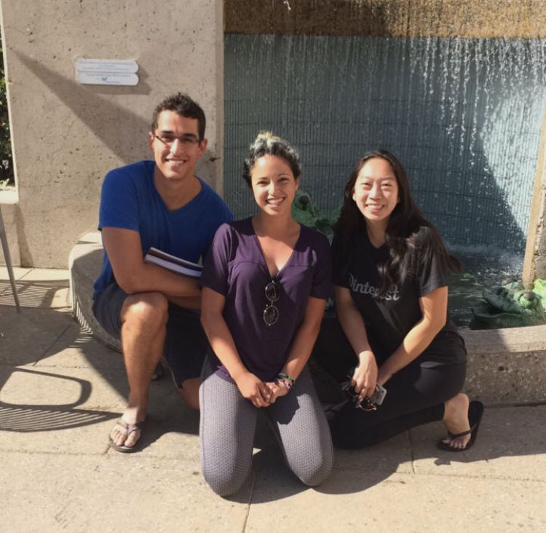
Overview
Notes:
There are a lot of unsatisfied customers and a lot of room for improvement.
We began with a simple proposition; what we hope our product will accomplish.
From there, we worked to develop multiple design interfaces and picked one to develop a prototypical interface with basic user functionality that will be the backbone to our product.
We then designed tasks with varying difficulty that we would employ on local shoppers.
After we gathered our data, we analyzed the results to discover that, while our product has a lot of potential, there are several features that we will have to modify to ensure the best shopper experience.

Slide 5
Overview
Value Proposition
Selected Interface
Low-Fi Prototype
Task Flows
Methods
Results
UI Changes
Notes:
click

Slide 6
Overview
Value Proposition
Selected Interface
Low-Fi Prototype
Task Flows
Methods
Results
UI Changes
Notes:
- Let’s talk about our vision.

Slide 7
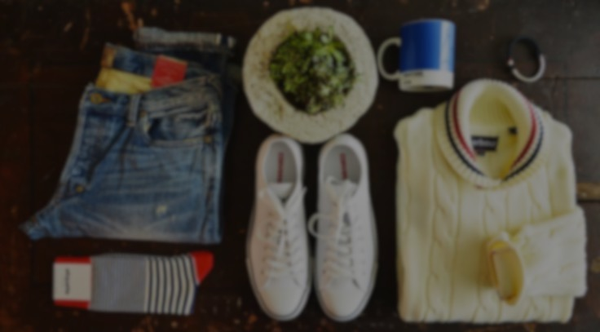
Shopping made easy
Notes:
We narrowed our focus on a problem that many shoppers face: the frustration of finding clothes in a store in an efficient way
We believe the solution to this problem is to “augment” our reality: that is, to use current mixed reality technologies to make a mannequin appear in the store front that is wearing clothes that the store currently holds.
Our solution lends itself to our mission statement: “Shopping made easy”
We want our users to feel alleviated from the stress and time-consumption of shopping so that they can focus their energy on what makes them happy. We also want to enable our users to feel more connected to their friends; after all, everyone has to shop at one point, so why not do it together?

Slide 8
Overview
Value Proposition
Selected Interface
Low-Fi Prototype
Task Flows
Methods
Results
UI Changes
Notes:
click

Slide 9
Overview
Value Proposition
Selected Interface
Low-Fi Prototype
Task Flows
Methods
Results
UI Changes
Notes:
- With our mission in mind, we moved on to develop several interfaces for our product and decided that…

Slide 10
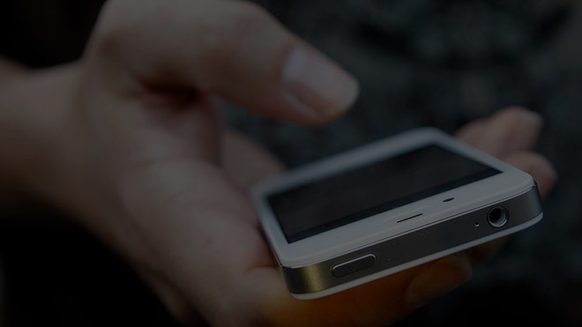
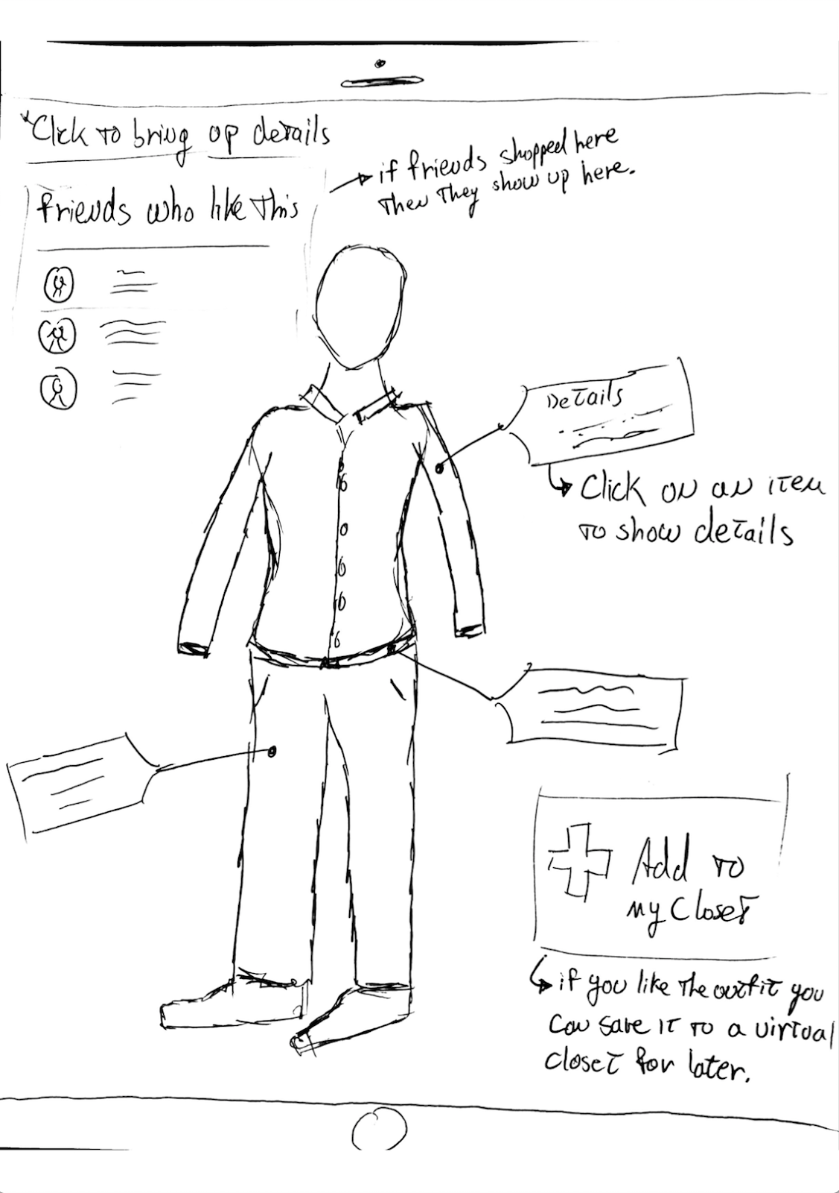
Mobile Application
Prevalence
Accessible Camera
Sharing Features
Simple UI
Notes:
The mobile application is the way to go
Why a phone over a headset, projector, or wearable, you may ask?
First off, almost everyone carries a smartphone, especially when they are out shopping for clothes, whereas the previously mentioned mediums are not all that common
Secondly, smartphones have a camera that is very easy for a shopper to point at a store front, while other interfaces struggle to match a phone camera’s accessibility
Thirdly, phones make it easy for people to share things with friends, and since we want our application to serve as a social platform for shoppers to connect, a mobile design makes the most sense
Finally, phones have a simple UI that people are already familiar with; we simply want to build off of UI that already exists.

Slide 11
Overview
Value Proposition
Selected Interface
Low-Fi Prototype
Task Flows
Methods
Results
UI Changes
Notes:
We settled upon our interface of choice
click

Slide 12
Overview
Value Proposition
Selected Interface
Low-Fi Prototype
Task Flows
Methods
Results
UI Changes
Notes:
- But now, it is time to make big decisions about our application’s user interface

Slide 13
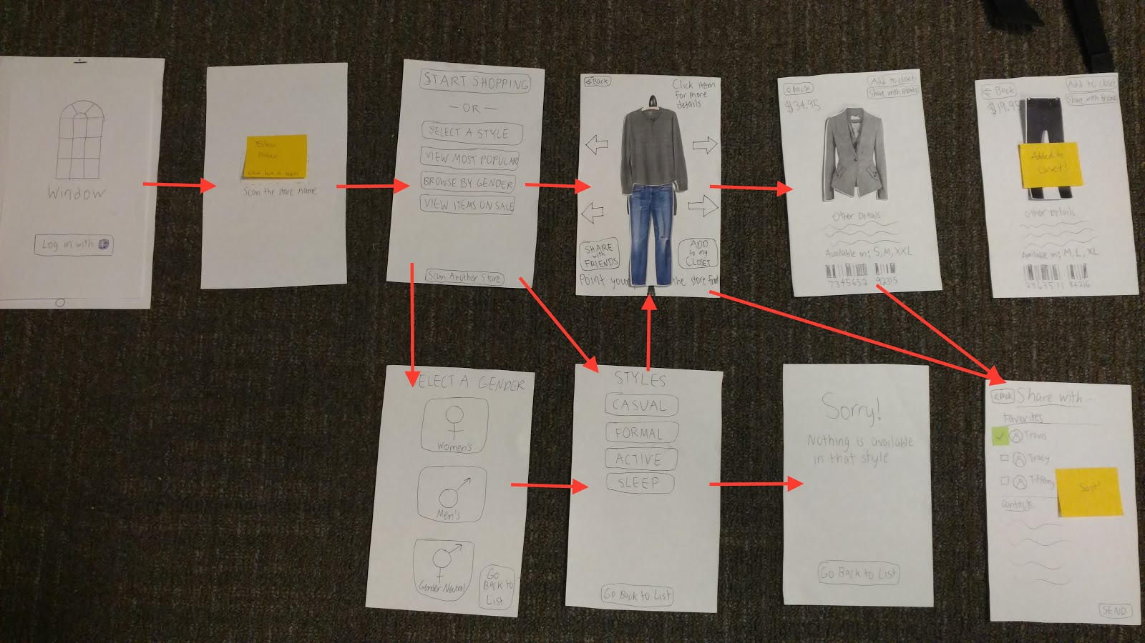
Notes:
To make the user’s prototypical experience as similar to what we hope our application to be in release, we designed our low-fi prototype to resemble a smartphone using cropped pieces of paper.
Our user starts on a home screen from which they can log in.
From there, they are requested to use their camera to scan the name of the store that they are interested in.
A button will appear in place of the store’s name, which the user can click to see all of their browsing options
They can choose to filter items by style, most popular, gender, and what’s on sale, or they can jump right to shopping, but whichever option they choose leads to a new screen which reactivates the user’s camera
They are prompted to hold their phone up against the store front. Once they do this, a mannequin will “appear” in the store front using augmented reality
This mannequin will have clothes wrapped around it that the user has the option to swipe out for other clothes by simply swiping left or right on the item.
When they see an item that they want to learn more about, they can click on the item, which will switch them to a screen showing the item outside of the mannequin’s outfit, as well as details such as the item’s price, sizing options, availability, brand name, and a bar code which they can use to identify the item.
On this screen, they have several options. They can either go back to swiping on more clothes, add it to their closet, which is our visual representation of favorited clothes, or send it to their friends.

Slide 14
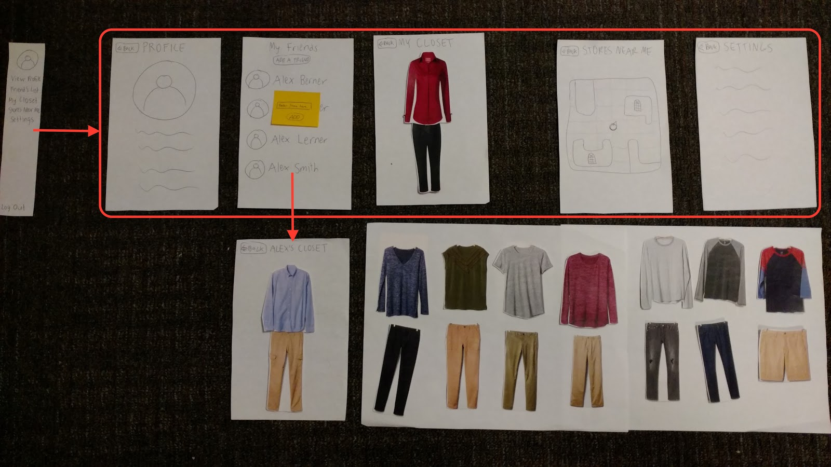
Notes:
We have included a sidebar, which can be accessed by swiping from the left side of the screen
Features of this sidebar include viewing your profile, your friends list, their virtual closets, your own virtual closet, a map that shows other Window-enabled stores near you, and your user settings.

Slide 15
Overview
Value Proposition
Selected Interface
Low-Fi Prototype
Task Flows
Methods
Results
UI Changes
Notes:
Our prototype was essentially completed.
click

Slide 16
Overview
Value Proposition
Selected Interface
Low-Fi Prototype
Task Flows
Methods
Results
UI Changes
Notes:
Our next step was to design several task flows for our user to test.
click

Slide 17
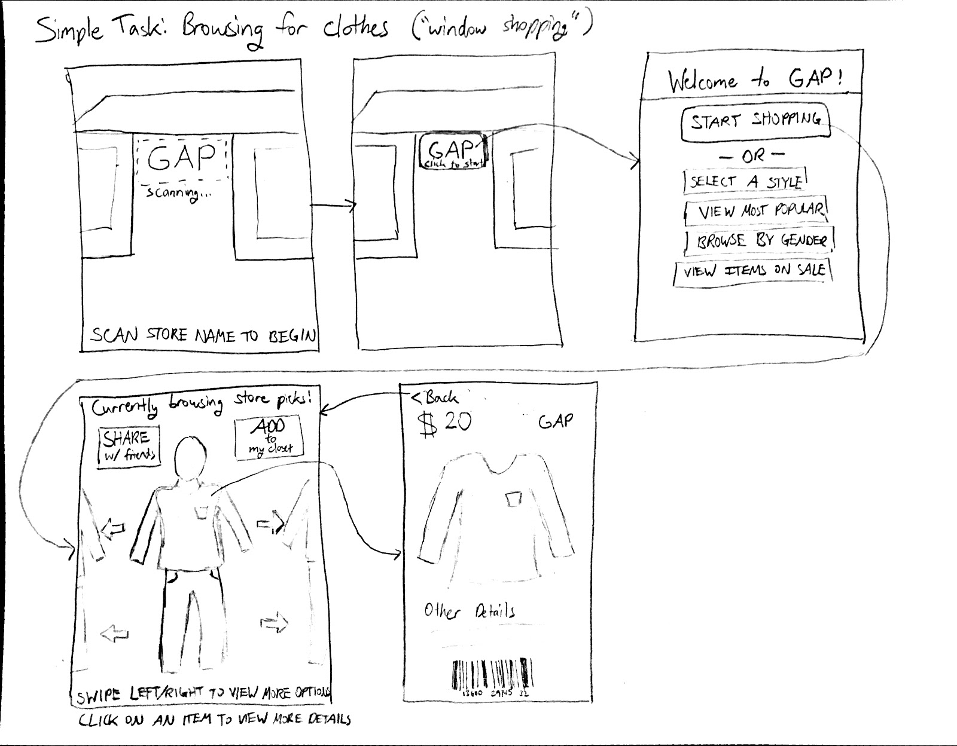
Simple Task
Notes:
We started with a simple task: to browse through a store’s virtual inventory
Our hope was that a user could practice using our application’s main functionality, and the task was designed to highlight any major UI flaws navigating through the basic screens of the application

Slide 18
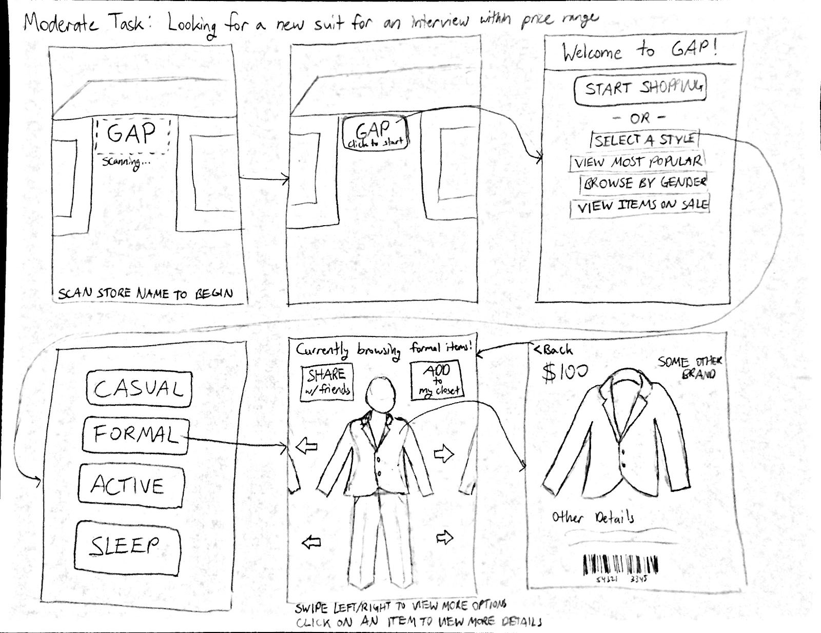
Moderate Task
Notes:
We then designed our moderate task: to find a top for an interview that fits within a $30 budget.
We hoped that with this task, our user would use our filtering options to find formalwear, then they would check out the details of items to check for their prices.

Slide 19
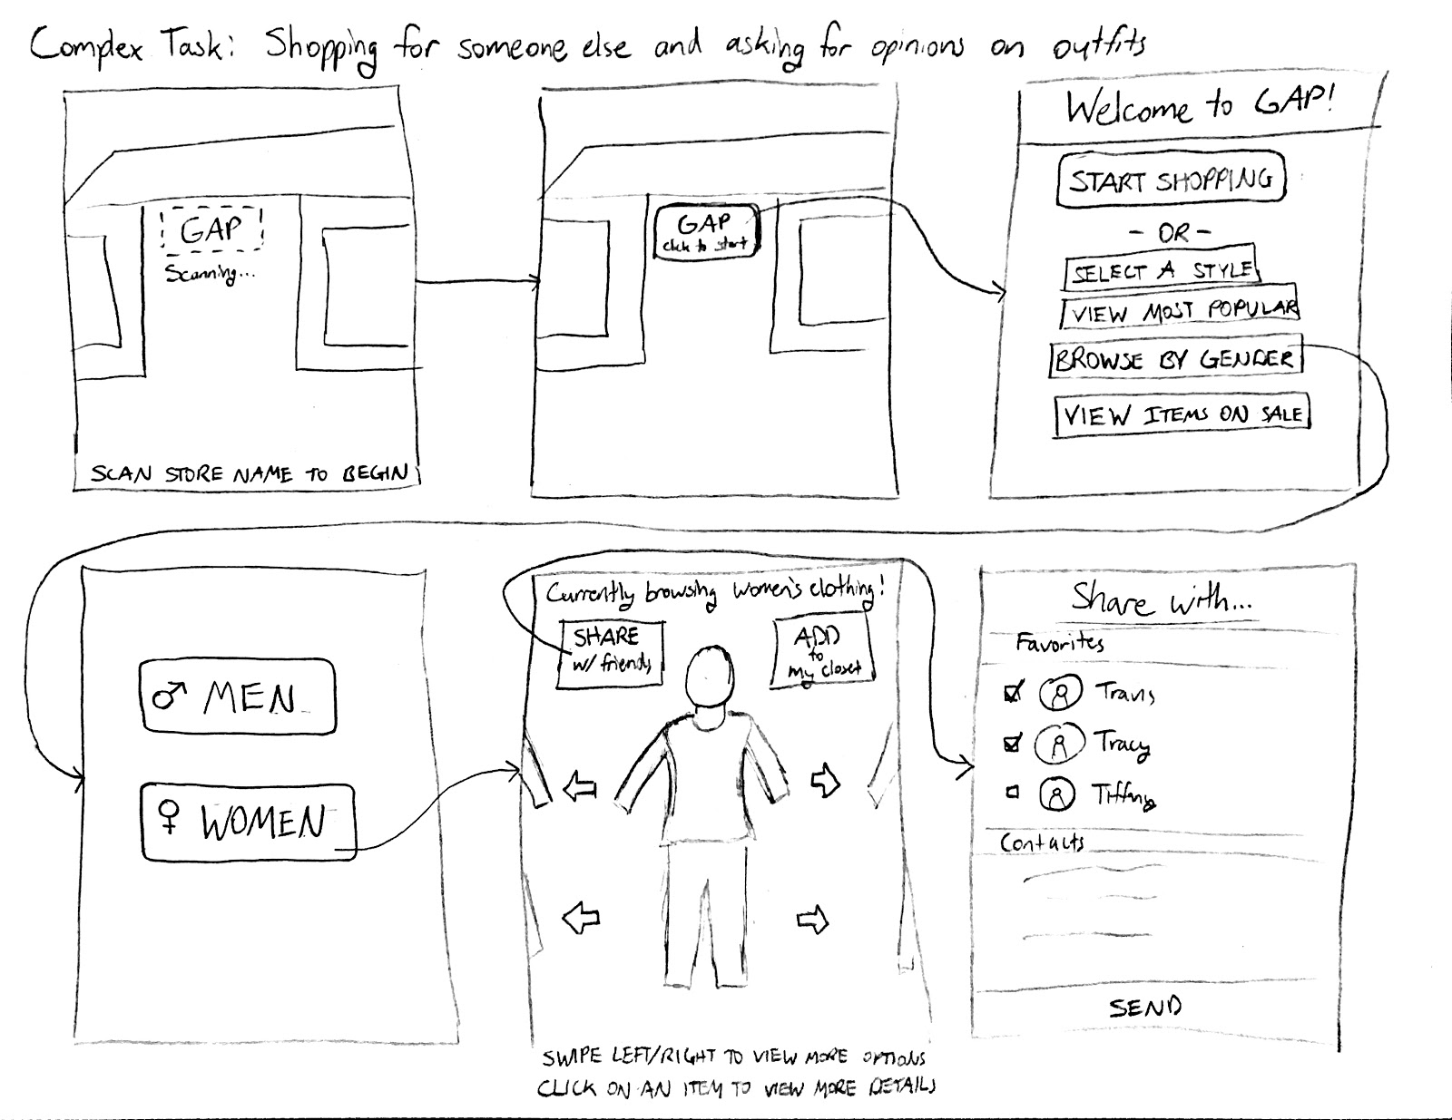
Complex Task
Notes:
Lastly, we made our complex task: to find an item for someone of the opposite gender in a specific size, then send that item to them virtually
Our goal was for our user to use our gender filtering options to find an item, then to use our sharing option to select their friend with whom they want to share the item.

Slide 20
Overview
Value Proposition
Selected Interface
Low-Fi Prototype
Task Flows
Methods
Results
UI Changes
Notes:
At this point, we have our interface, our low-fi prototype, and the tasks we want users to complete
click

Slide 21
Overview
Value Proposition
Selected Interface
Low-Fi Prototype
Task Flows
Methods
Results
UI Changes
Notes:
It’s time to let the shoppers test out our product.
click

Slide 22

Methods
Stanford Shopping Center
Three Diverse Shoppers
Our Roles
Quick Demo
Assign Tasks
Testing Measures: AR, pauses, strange clicks
Notes:
We went to the Stanford Shopping Center to scope out participants to test our prototype. Here there is already an abundance of stores and shoppers, who are our target audience.
We selected three participants and diversified our pool by selecting based on gender, race, and reason for being there
While they received no compensation for their time, they were more than happy to try out something ”cool”.
To set up our prototype, we had our “computers” Max and Kristen flip through the various screens of our application as they were accessed, but we allowed the user to hold our makeshift smartphone as Max and Kristen overlaid different screens based on the user’s input.
My role was to describe the tasks. I wrote a script so that we could maintain continuity among our various testers. I also recorded how our tester reacted to various features of the prototype as well as how they struggled or succeeded with certain aspects of the app.
Together, we introduced ourselves and our product to our participants and demonstrated how to log into our application and access the side bar. We then informed them that we would ask them to complete several tasks, for which we would not offer guidance. After they attempted the three tasks, we asked them what they thought of the prototype overall.
We had three testing measures. How well did they understand when our application utilizes augmented reality, where users paused during tasks, and when a user made an expected or unexpected click. With these testing measures, we wanted to gauge our user’s overall experience of the application and their likelihood to use our app for shopping while quantifying the number of times that they had issues.

Slide 23
Overview
Value Proposition
Selected Interface
Low-Fi Prototype
Task Flows
Methods
Results
UI Changes
Notes:
Once we collected our data, we all sat down together to discuss the results
click

Slide 24
Overview
Value Proposition
Selected Interface
Low-Fi Prototype
Task Flows
Methods
Results
UI Changes
Notes:
click

Slide 25
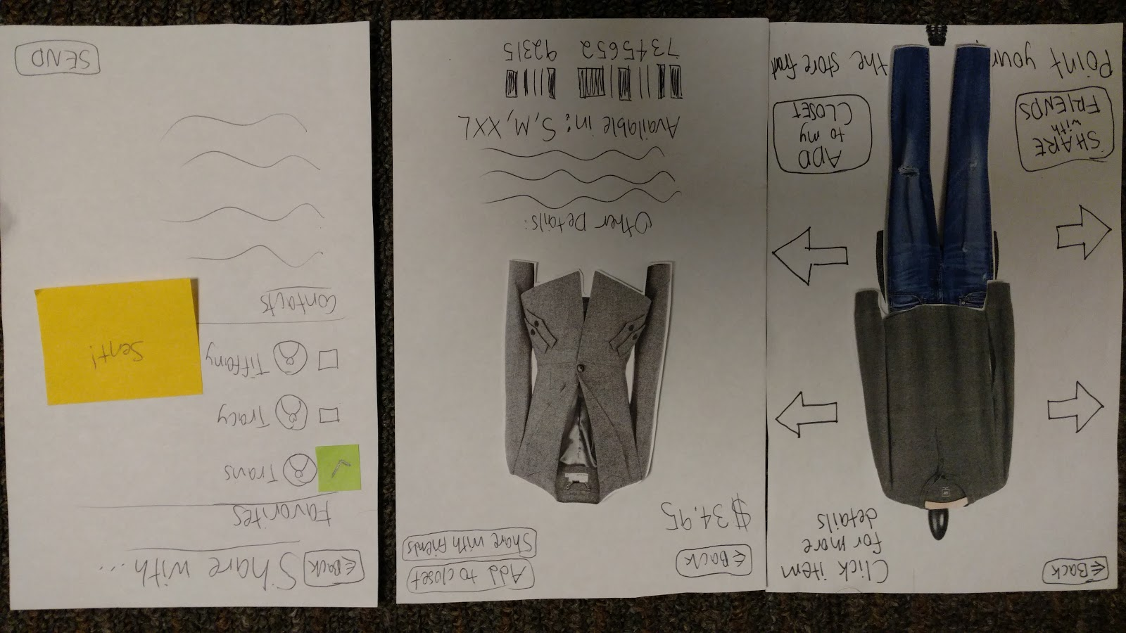
Results from Simple Task
The Good:
Enthusiasm
Novelty
The Bad:
Swiping
When is it AR?
Notes:
We received a wide range of feedback for our simple browsing task
The pluses were that people were excited about the potential of our project, and that they would love to see something like this become more prevalent in shopping
The minuses were that people didn’t seem to understand the swiping feature of our app: they simply clicked on the arrows to view different items. Additionally, they were confused about when to use the AR features of our application, but this may be due to the fact that they were working with pieces of paper.

Slide 26
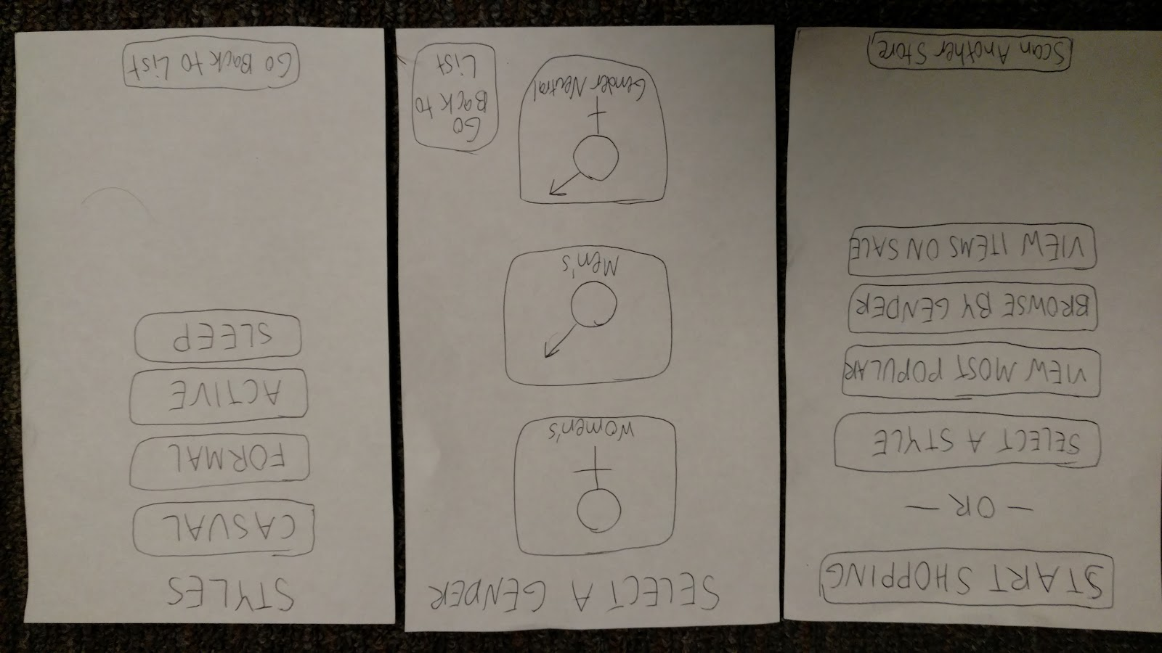
Results from Moderate Task
The Good:
Details Screen
Filters
The Bad:
Viewing price
Try it on
Notes:
Meanwhile, our moderate task to find a specific item seemed more straightforward for users.
Positive feedback we received was that the details screen would be very useful while window shopping. They also had an easy time using the filter features to find a formal top.
Parts of this task that they struggled with were finding the prices of the items; they had hoped that they could see the price while still on the AR enabled screen. Another complaint we received was that the participant could not try on the clothes himself with augmented reality.

Slide 27
Results from Complex Task
The Good:
Easy Sharing
Easy Sizing
The Bad:
Options
Closet?
Notes:
Our complex task to share with a friend also was received well by our users.
The good parts were that they had an easy time reaching our friend list screen from which they could select someone to share their item with. They also had a relatively easy time finding an item in the correct size because they would check the details screen regularly for an item.
The bad parts were that our participants did not try to look through different options; often, they would find an item that met the requirement and settle with it. This may have been due to time constraints on their part, but perhaps we did not make it clear that there are multiple options for clothing types. They were also confused by the “add to closet” feature. One of our participants believed that the “add to closet” feature was how to purchase the item, when our intention for it was to serve as a favorites page.

Slide 28
Overview
Value Proposition
Selected Interface
Low-Fi Prototype
Task Flows
Methods
Results
UI Changes
Notes:
We aggregated our results to come to several conclusions
click

Slide 29
Overview
Value Proposition
Selected Interface
Low-Fi Prototype
Task Flows
Methods
Results
UI Changes
Notes:
click

Slide 30
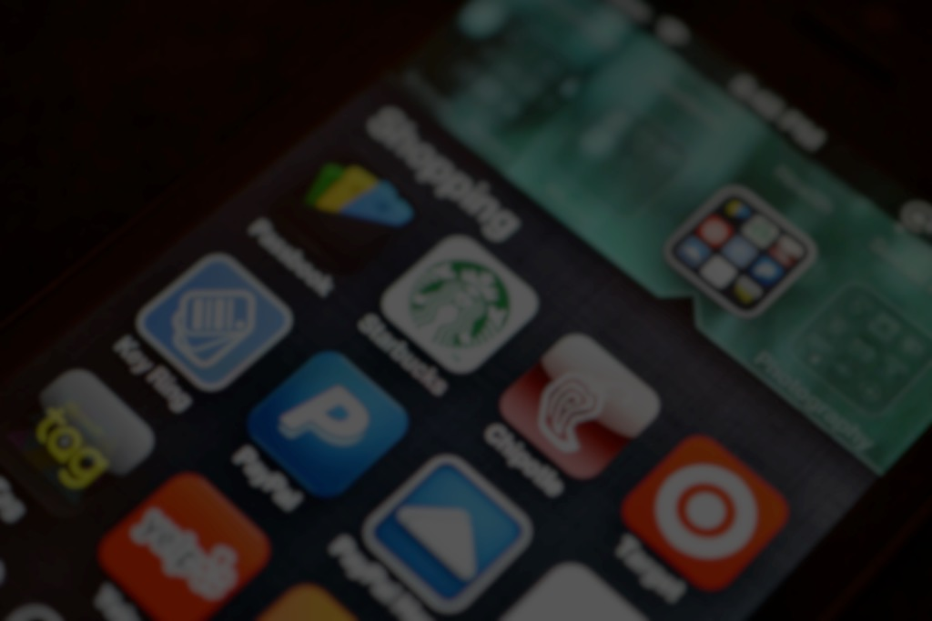
UI Changes
Remove the “Start Shopping” button
Make swiping more intuitive
Distinguish closet from purchase
Notes:
Overall, participants seemed very content with our product features and capabilities. We were relieved to find out that people would want to use our application.
Changes we would like to make based on the feedback we received are to remove the start shopping button when a user scans in a store name.
We would also like to make the swiping feature of our application more intuitive to users
A big change that we foresee in our application is clarifying the purpose of the closet feature. Our participants often confused the “Add to Closet” feature to making a purchase, and at times it served as a distraction from completing the task. Moving forward, we would like to make the difference between our closet feature and actually buying an item clearer.

Slide 31
Overview
Value Proposition
Selected Interface
Low-Fi Prototype
Task Flows
Methods
Results
UI Changes
Notes:
Let’s do a brief wrap-up of this talk
click

Slide 32
No more stress
“Shopping made easy”
Mobile
Paper phone
Three tasks
Stanford mall shoppers
People like it but it’s not clear
Streamline and assist
Notes:
We want to make shopping a less stressful and time-consuming experience for people
In essence, our goal is to make shopping easy
The best way to accomplish this is through a mobile interface, for which we made a low-fi prototype out of paper
We designed three different tasks related to a typical shopping experience which we tested on shoppers at our local mall
And from the feedback we received, people love this idea but aren’t entirely sure how to use it in practice
With this information, we will modify our prototype so that it is easier to access the main features and use it in tandem with the in-person shopping experience.
In short, we want to improve our product so that “shopping made easy” is even easier.
click

Slide 33

Questions?
Notes:
- Thank you for your time!

